Slide 1

Geometry
Unit 4, Lesson 8 Putting It All Together Volume 1, pg. 217

Slide 2


Benchmarks
MA.912.GR.2.3
Identify a sequence of transformations that will map a given figure onto itself or onto another congruent or similar figure.
MA.912.GR.2.6
Apply rigid transformations to map one figure onto another to justify that the two figures are congruent.
volume 1, pg. 217

Slide 3
Integrated Mathematical Thinking and Reasoning Standards
MA.K12.MTR.1.1 Actively participate in effortful learning both individually and collectively.
MA.K12.MTR.2.1 Demonstrate understanding by representing problems in multiple ways.
MA.K12.MTR.3.1 Complete tasks with mathematical fluency.
MA.K12.MTR.4.1 Engage in discussions that reflect on the mathematical thinking of self and others.
MA.K12.MTR.5.1 Use patterns and structure to help understand and connect mathematical concepts.
volume 1, pg. 217

Slide 4

Learning Targets
I can determine a sequence of transformations that map one figure onto another congruent figure.
I can match the written and algebraic descriptions of a sequence of transformations given the preimage and image of a figure.
volume 1, pg. 217

Slide 5

Warm-Up
volume 1, pg. 218

Slide 6
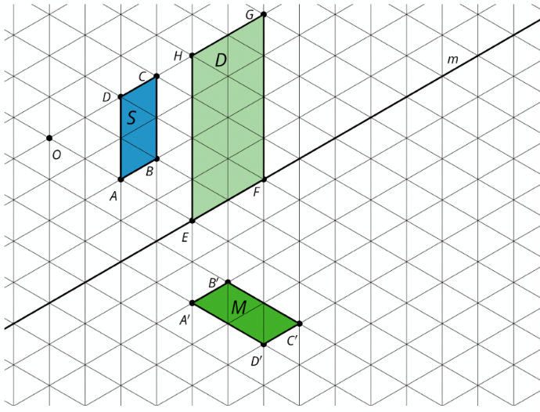
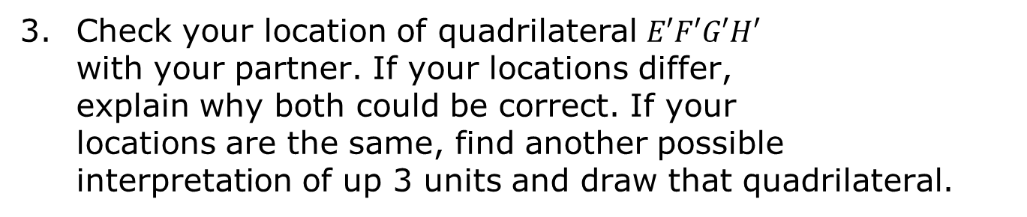
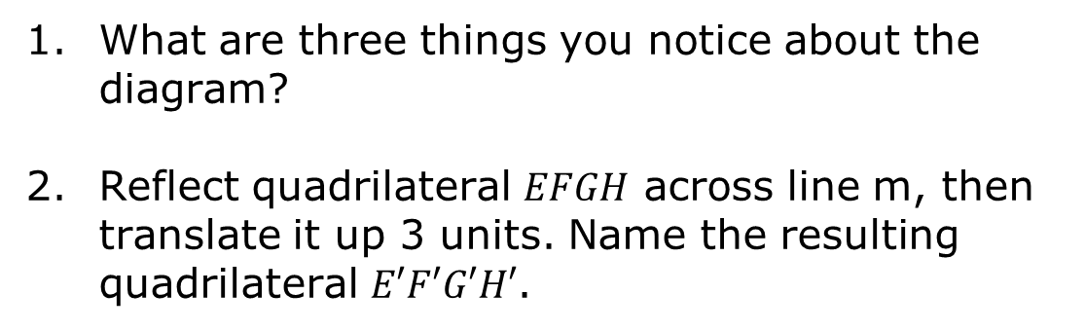
4.8.1 Warm-Up: Notice and Wonder
What are three things you notice about the diagram?
Reflect quadrilateral $EFGH$ across line m, then translate it up 3 units. Name the resulting quadrilateral $E′F′G′H′$.
Check your location of quadrilateral $E′F′G′H′$ with your partner. If your locations differ, explain why both could be correct. If your locations are the same, find another possible interpretation of up 3 units and draw that quadrilateral.
volume 1, pg. 218

Slide 7

Activity
volume 1, pg. 218

Slide 8

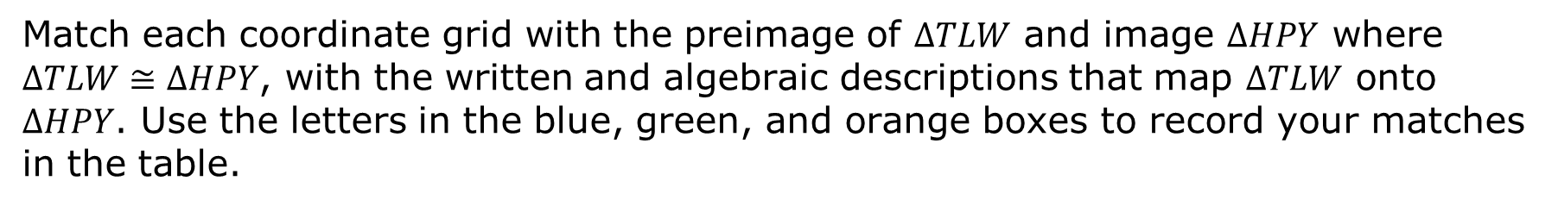
4.8.2 Activity: Card Sort
Match each coordinate grid with the preimage of $∆TLW$ and image $∆HPY$ where $∆TLW≅∆HPY$, with the written and algebraic descriptions that map $∆TLW$ onto $∆HPY$. Use the letters in the blue, green, and orange boxes to record your matches in the table.
Coordinate Grid | Written Description | Algebraic Description
B
D
F
volume 1, pg. 218

Slide 9
Coordinate Grid | Written Description | Algebraic Description
G
H
M
T
W
X
Y
volume 1, pg. 218

Slide 10

Wrap-Up
volume 1, pg. 219

Slide 11
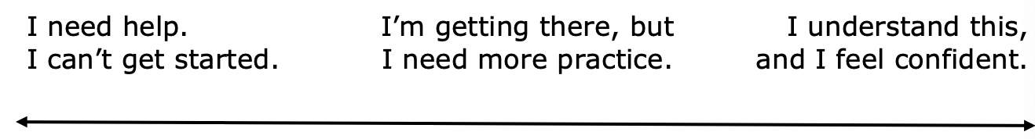
4.8.3 Wrap-Up: Reflection
Draw an X on each line to indicate where your current learning is in relation to each target.
I can match the written descriptions of a sequence of transformations to the coordinate grid with the preimage and image.
volume 1, pg. 219

Slide 12
I can match the algebraic descriptions of a sequence of transformations to the coordinate grid with the preimage and image.
I can determine a sequence of transformations that map one figure onto another congruent figure.
volume 1, pg. 219

